Slide 1
THE MODERN TRUST THE ART OF PROPERLY (AND EFFECTIVELY) PASSING AND RECEIVING WEALTH
Sioux Falls
Estate Planning Council
May 18, 2017
Richard A. Oshins, AEP (Distinguished)
Oshins & Associates, LLC
1645 Village Center Circle, Suite 170
Las Vegas, Nevada 89134
702.341.6000 / 702.341.6001 fax
roshins@oshins.com
www.oshins.com
Copyright 2017 by Richard A. Oshins. All Rights Reserved

Slide 2
THOUGHT PROVOKING IDEAS PLANNING OPPORTUNITIES
Many of the discussion items contain planning thoughts that should always be considered. Alternatively, reasonable advisors may conclude differently with other proposals and approaches.

Slide 3
WHY ARE ALMOST ALL TRUSTS?
Poorly/Inefficiently/Erroneously Designed?
Take So Long To Draft?
Or, Not Done at All?

Slide 4
PRIMARY DISCUSSION TOPICS
Is There a Single “Best” Trust Design Strategy?
Structuring Trusts
◊ The Competent Inheritor
◊ Others
The “Use” Trust – Simpler Than a RT
Modern Trust Design Offers Powerful I/T Shelter Opportunities

Slide 5
CLIENT’S PRINCIPAL OBJECTIVES*
Reduce or Eliminate Taxes
Creditor Protection
Pass Wealth the “Right Way”
*Of course, there are other goals such as liquidity.

Slide 6
COMMON QUOTES
“All I Want is a Simple Will”
“My Clients Don’t Want the Complexities of Trusts”

Slide 7
REBUTTAL
“Then You Need to Try Harder!”
“Your Clients Will do What You Tell Them to Do!”

Slide 8
CONSEQUENCES OF NOT PLANNING PROPERLY
“The old refrain, “All I want is a simple will,” helps explain why so many people, including many advisors who should know better, so often overlook trusts when planning for the transfer of wealth as an inheritance within the family. In the rush to achieve simplicity, such persons fail to realize the enormous, unnecessary and irretrievable loss of assets (to taxes, divorce, and creditors) that many families will suffer for failing to appreciate the protections that a trust can provide when passing wealth from generation to generation. To quote from an excellent article on the subject, “trusts should be the vehicles of choice for all dispositions to individuals.”
* Ronald D. Aucutt, Structuring Trust Arrangements for Flexibility, 35 U. Miami Inst. Est. Plan., Ch. 9 (2001)

Slide 9
IT HELPS TO EVALUATE THE ESTATE PLANNING PROCESS IN THE CONTEXT OF A BUSINESS DECISION
Would You Ever Recommend a Business Entity That Could Be Pierced By Creditors?
Would you Ever Recommend a Business Entity That Would Be Subjected to Unnecessary Taxes?
Why Would a Client Want and/or an Advisor Suggest (or Summarily Accept) Wealth Transfers That Unnecessarily Expose Wealth to Claimants and the Taxing Authorities?

Slide 10
COMMON GOALS
Business Entity
◊ Creditor Protection
◊ Tax Avoidance
Estate Planning
◊ Creditor Protection
◊ Tax Avoidance

Slide 11
ADVISOR’S ATTITUDES BUSINESS PLANNING v. ESTATE PLANNING
In Business Planning - Advisors Never Would Summarily Accept a Client’s Pushback Regarding the Implementation of an Entity
Why Does a Passive Attitude Occur With Regularity in the Context of Trust Planning?

Slide 12
CLIENT’S “WISH” LIST
1. Control
2. Use and Enjoyment
3. Flexible/Amendable
4. Creditor/Divorce Protection
5. Save Taxes
6. Avoid Complexity

Slide 13
SHOW “WISH” LIST TO CLIENTS
❑ “Is There Anything That You Don’t Want For Yourself?”
“Is There Anything Else You Want?”
“Which of These Do You Want (or Not Want)”
◊ “For Your Children?”
◊ “For Others?”
❑ Clients Will Always Want Shelters, But May Vary Controls

Slide 14
IS THERE A “BEST” TRUST DESIGN STRATEGY TO OBTAIN ALL OF THE COMPONENTS OF THE “WISH” LIST?
Simplicity
Shelters
Controls

Slide 15
PRIMARY TRUST DESIGN STRATEGIES
Maximum Benefit Trust
◊ Entitlements
◊ Force-outs
Fully Discretionary Trust
◊ Requires an “Independent Trustee”
Professional Trustee

Slide 16
MAXIMUM BENEFIT TRUST COMPONENTS
❑ Pay the Income Annually or More Frequently
❑ HEMS
❑ Power to Withdraw Greater of 5% or $5,000
❑ Staggered Distributions
❑ Beneficiary Can Be Sole Trustee

Slide 17
DISCRETIONARY TRUST COMPONENTS
❑ Fully Discretionary
❑ Dynastic
❑ Beneficiary-Controlled (at Proper Time(s))
❑ “Use” Concept
❑ Amendable - Broad SPAs – “Re-Write Powers”
❑ Favorable Situs
❑ Requires an Independent Trustee

Slide 18
TRADITIONAL “MAXIMUM BENEFIT TRUST” PROCESS
❑ Give Menu of Available Options
Client (With Guidance) Selects Options
Law of Unintended Consequences
◊ More is Not Always Better
◊ Does Client Really Understand Full Impact of Choices?

Slide 19
“PERFECT TRUST” DESIGN PROCESS REVERSE ENGINEERING
❑ Start With the “Wish” List
◊ How Do We Obtain All Components
❑ Trust Design Always Preserves Protections and Simplicity
Make Minimal, But Meaningful Alterations ◊ Adjust Controls and Guidance

Slide 20
MAXIMUM BENEFIT TRUST TAX AND CREDITOR SHELTER INEFFICIENCIES AND FLAWS Violates “Wish” List

Slide 21
PAYS OUT INCOME AT LEAST ANNUALLY
❑ Force-outs Terminate “In-Trust” Shelters ◊ Transfer Tax Inefficient – Leakage
◊ Income Tax Inefficient
◊ Creditor Exposed

Slide 22
ASCERTAINABLE STANDARD “HEMS”*
❑ “Support Trust” Issue**
❑ Relies on Spendthrift Trust Provision
❑ Exception Creditors
◊ Statutorily Created – See Restatement 2nd
◊ Judicially Created – Bacardi v. White, 463 So. 2d 218 (Fla. 1985); Garretson v. Garretson
(306 A. 2d 737 (Dela. 1973))
* Some State Statutes Protect HEMS Trusts; Will That Be Respected By Judges In Other Jurisdictions If There Is No Other Contacts With The Governing Law States?
**Steven J. Oshins, Asset Protection Other Than Self-Settled Trusts: Beneficiary Controlled Trusts, FLPs, LLCs, Retirement Plans and Other Creditor Protection Strategies; The 39th Annual Heckerling Institute on Estate Planning, University of Miami School of Law, June 2005.

Slide 23
LAPSING POWER TO WITHDRAW “5% OR $5,000” ANNUALLY
❑ Estate Tax Exposure
❑ Creditor Protection Adversely Impacted
❑ Income Tax Inefficient PLR 9034004
❑ Administrative Nightmare
◊ Expense
◊ Added Complexities

Slide 24
DISTRIBUTES ASSETS AT SPECIFIED AGES
❑ Force-outs Terminate “In Trust” Shelters
❑ At What Age Do You Distribute From a By-Pass Trust?
❑ Multiple “Bite of the Apple” Alternative
◊ Distribute to a BCT

Slide 25
THE ANATOMY OF THE PERFECT TRUST Component Analysis
Fred Keydel and Harvey Wallace; Design Strategies for Dynasty Trusts; ACTEC March 6, 1999
Ronald D. Aucutt, Structuring Trust Arrangements for Flexibility, 35 U. Miami Inst. Est. Plan., Ch. 9 (2001)
T. Calleton, N. McBryde and R. Oshins, Building Flexibility and Control Into The Estate Plan– Drafting From The Recipient’s Viewpoint, NYU 61st Institute on Federal Taxation
Richard A. Oshins and Steven G. Siegel, The Anatomy of the Perfect Modern Trust – Parts 1 & 2, Estate Planning (Jan and Feb 2016)

Slide 26
THE PERFECT TRUST PHILOSPHY
❑ “Own Nothing; But Control Everything”*
❑ Satisfies All Components of the “Wish” List
❑ Legal Title Creates Exposure to Predators and the Taxing Authorities
*Quote attributable to John D. Rockefeller

Slide 27
THE PERFECT TRUST
Dynastic; Discretionary (with distribution discretion in the hands of an Independent Party who can be fired and replaced); Beneficiary Controlled Trust (unless (i) controls are undesirable or (ii) impermissible under law to avoid the taxing authorities and other claimants); where the use of trust assets rather than distributions are encouraged (unless distributions are beneficial or desirable); sitused in a trust-friendly jurisdiction.

Slide 28
MORE IS NOT ALWAYS BETTER

Slide 29
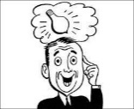
COMMON COMPONENTS
❑ Do These Help?
◊ Pay Out Income at Least Annually
◊ Ascertainable Standard (“HEMS”)
◊ Lapsing “5 or 5” Power
If They Do Not Improve the Trust Then
Why Use Them?

Slide 30
FREQUENTLY USED TRUST PROVISIONS
❑ Beneficiary v. Third Party Controlled Trust
◊ Investment Committee
◊ Distribution Committee
❑ Do They Add Anything to a BCT?
❑ Perception (and Reality)
◊ Too Complex
◊ Too Controlling

Slide 31
OBTAINING “WISH” LIST COMPONENTS

Slide 32
3.1.1 Discretionary Distributions of Income and/or Principal. The Independent Trustee, in its sole, absolute and unreviewable discretion, shall have the power, the exercise of which shall be absolutely binding on all persons interested now or in the future in this trust, to distribute to or apply for the benefit, enjoyment or use of any one or more of the following permissible distributes:
The primary beneficiary,
The spouse of the primary beneficiary,
The descendants of the primary beneficiary who are then living (even though not now living),
Any then living spouse of any such descendant who is then deceased (provided such spouse was living with such descendant at the time of such descendant’s death or was unable to do so for reasons of health), and/or
Any trust for the primary benefit of any one or more of the above-described permissible distributees (even one created by the Independent Trustee hereunder), whether now existing or hereafter created, except…
so much of the income or principal, or both, of the trust estate, in equal or unequal proportions, and at such time or times as such Independent Trustees shall deem appropriate for such beneficiaries’ benefit, care, comfort, enjoyment or for any other purposes, after taking into consideration their income or other resources…

Slide 33
SIMPLICITY THE “USE” TRUST SIMPLER THAN A REVOCABLE TRUST
WISH LIST – COMPONENTS #6 AND #2

Slide 34
“USE” TRUST KEY CONCEPTS*
❑ Keep “Legal Title” In Trust Wrapper
❑ Just “Use” Trust Assets
❑ Available to All Beneficiaries
◊ To Primary Beneficiary on a Preferential Basis
* See Richard A. Oshins, Megatrusts™; Representation Without Taxation; NYU 48th Inst. On Federal Taxation, Ch 19 (1990); §19.02

Slide 35
RESULT ALL COMPONENTS OF “WISH” LIST
❑ Full
◊ Control
◊ Use and Enjoyment
❑ Full
◊ Shelter

Slide 36
“USE” TRUST EQUALS SIMPLICITY
❑ Similar to a Revocable Trust
❑ Except
◊ No Gratuitous Transfers
◊ Income Tax Return for Non-Grantor Trust

Slide 37
HOW SIMPLE IS THE “USE” TRUST?
❑ Simpler than Outright
◊ Long Term
❑ What is Complex?

Slide 38
DISTRIBUTIONS ARE PERMISSIBLE, BUT DISCOURAGED
❑ Unless there is a Compelling Reason to Make Them
◊ Needed
◊ Wanted
◊ Makes Sense
❑ Consider “F/B/O”
❑ Separate the Fruit From the Tree

Slide 39
A VOLUNTARY TAX?
WISH LIST #5 – Transfer Taxes

Slide 40
TRANSFER TAXES
“In fact, we haven’t got an estate tax, what we have is, you pay an estate tax if you want to; if you don’t want to, you don’t have to.”
– Professor A. James Casner
Estate and Gift Taxes: Hearings Before the House Ways and Means Committee 94th Congress, 2d. Sess., pt. 2, 1335 (March 15-23, 1976)

Slide 41
TRUSTS AS THE QUINTESSENTIAL INCOME TAX SHELTER
WISH LIST #5 – INCOME TAX PLANNING

Slide 42
TRUSTS OFFER SUBSTANTIAL INCOME TAX PLANNING OPPORTUNITIES NOT AVAILABLE WITH OUTRIGHT TRANSFERS
❑ Rethinking Trusts as an Income Tax Sheltering Strategy
◊ Misperception – Because of Compressed Trust Income Tax Brackets Trusts Are Inefficient
❑ Virtues
◊ Sprinkling to Low Brackets
◊ State Income Tax Avoidance Opportunities
◊ Basis Planning

Slide 43
BASICS
❑ Sprinkling
◊ Bracket Leveling
◊ 65-Day Rule
❑ State Income Taxes
◊ Compounding – The 8th Wonder of the World*
*Power of Compounding Attributed to Albert Einstein

Slide 44
COMPARISION OF PAYING STATE INCOME TAXES AND NOT PAYING THE OVER TIME
Impact of State Income Tax on Dynasty Trusts
This model compares the impact of state income tax for a dynasty trust over the period of 120 years. The hypothetical trust has one group of stock that pays annual dividends at a constant rate (x% of principal). The stock's value grows by y% per year. We assume that all dividends, after tax, are reinvested in the same stock. All income is in the form of dividends, so it is taxed as ordinary income. We compare the ultimate impact of the state income tax by comparing the value of the trust assets depending on whether the trust is situated in New York (outside New York City and within New York City), California, Massachusetts, or in a state that does not impose an income tax. The income tax rates are based on 2014 state rates, updated for 2015 when available, and 2015 Federal income tax rates.
 | Trust Principal | $1,000,000
 | Annual Dividends | 6%
 | Annual Appreciation of Principal | 0%
©2015 Chart prepared by Abigail O’Connor of Holland & Knight
abigail.oconnor@hklaw.com | www.hklaw.com

Slide 45
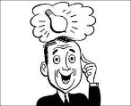
ADVANCED PLANNING USING TRUSTS ESPECIALLY GRANTOR TRUSTS
❑ Basis Bump Planning – Upstream and Lateral
Monitoring Grantor Trusts
Downstream Planning
Tax Burn Planning

Slide 46
REVERSE AND LATERAL PLANNING USING GPAs* - RULES
❑ IRC §2041 Inclusion
IRC §1014 Basis of Property Acquired From a Descendent
Previously Transferred Assets
◊ Carryover Basis
*And Delaware Tax Trap

Slide 47
BASIS BUMP PLANNING
Many People Will Die With Unused AEA
Expand List of Permissible Distributees of Trusts
◊ E.g., Parents, G/Ps; In-laws; Siblings…
Most Clients Will Want to Help Needy Parents/In-laws
Distribution Standards Can Vary
◊ Preferential Beneficiaries – Happiness
◊ Secondary - Need

Slide 48
INDEPENDENT TRUSTEE OR TRUST PROTECTOR CAN GIVE, TAKE AWAY AND DESIGN GPAs
Formula GPA
Ordering of Best Assets – e.g., -
◊ Low Basis/Negative Basis Depreciable Commercial Real Estate
◊ Capital Gain Assets
Ordering of Specific Assets

Slide 49
PREVENTING EXERCISE OF GPAs
❑ Can Require Prior Notice of Exercise –
Treas. Reg. §20.2041-3(b)
❑ Can Require Consent of a Non-Adverse Party – IRC §2041(b)(1)(c)(2)
❑ Beneficiary Does Not Have to Know of Existence of the Power – Estate of James C. Freeman

Slide 50
ILLUSTRATION:
❑ Client Doctor/Business Owner Owns Office Building
Beneficiary Grantor Trust – IRC §678
FMV $5 Million – Basis $1 Million
Parents, In-laws, Spouse Are Also Beneficiaries of Trust
All (5) Pre-decease Client
Query- What is the Value of the Multiple Basis Step-ups?

Slide 51
EXCHANGES WITH GRANTOR TRUSTS BY OWNER OF TRUST
❑ Rev. Rul. 85-13
❑ Trust Owns Low/Negative Basis Assets
Client Owns Assets – FMV Less Than Basis
Exchange
◊ Step-up For Decedent
◊ Preservation of Basis Transferred to Trust

Slide 52
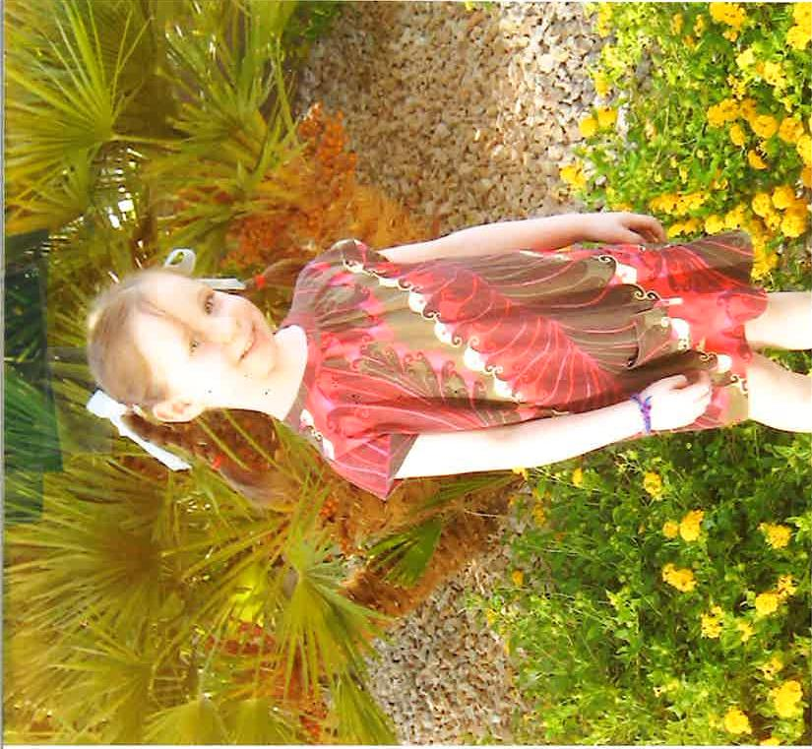
CASCADING BDITs

Slide 53
3.1.1 Discretionary Distributions of Income and/or Principal. The Independent Trustee, in its sole, absolute and unreviewable discretion, shall have the power, the exercise of which shall be absolutely binding on all persons interested now or in the future in this trust, to distribute to or apply for the benefit, enjoyment or use of any one or more of the following permissible distributes:
The primary beneficiary,
The spouse of the primary beneficiary,
The descendants of the primary beneficiary who are then living (even though not now living),
Any then living spouse of any such descendant who is then deceased (provided such spouse was living with such descendant at the time of such descendant’s death or was unable to do so for reasons of health), and/or
Any trust for the primary benefit of any one or more of the above-described permissible distributees (even one created by the Independent Trustee hereunder), whether now existing or hereafter created, except…
so much of the income or principal, or both, of the trust estate, in equal or unequal proportions, and at such time or times as such Independent Trustees shall deem appropriate for such beneficiaries’ benefit, care, comfort, enjoyment or for any other purposes, after taking into consideration their income or other resources…

Slide 54
STRATEGY
❑ Independent Trustee Sets Up BDITs
◊ For Spencer’s New Business
◊ For Katie’s Existing Business
❑ Sharing Not Desirable
◊ Controls
◊ Fruits of Sweat Equity

Slide 55
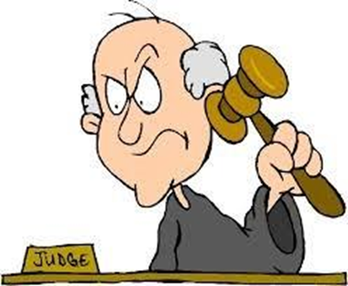
CREDITOR AND DIVORCE PROTECTION
WISH LIST #4 – CREDITOR/DIVORCE PROTECTION

Slide 56
CREDITOR PROTECTION IS AS MUCH A PART OF ESTATE PLANNING AS TAX PLANNING*
❑ Asset Protection Maximum
❑ Legal Title Harmful
*Attributable to Skip Fox “Current Financial and Estate Planning Trends”, CCH Financial and Estate Planning, (Nov 26,2007), “… I would argue that there may very well be an affirmative duty to talk to your clients about (an asset protection trust).” at p. 83 and, "…it could be any advisor.” at p. 84.

Slide 57
PROTECTION FROM CLAIMANTS
“A discretionary trust with “… the distribution discretion held by an independent trustee… is the ultimate in creditor and divorce claims protection – even in a state that restricts so called ‘spendthrift’ trusts – since the beneficiary himself has no enforceable rights against the trust.” (Emphasis supplied)
Frederick R. Keydel
“Trustee Selection, Succession, and Removal: Ways to Blend expertise with Family Control,” 23 U. Miami Inst. On Est. Plan., Ch 4 (1989) at §409.1
Caveat - Under Current Law, I Would Add, “provided that the trust is sitused in a trust friendly jurisdiction”.

Slide 58
REASONABLE CONTROLS, USE AND BENEFICIAL ENJOYMENT DO NOT SACRIFICE SHELTERS
❑ Controls
◊ Managerial Control Not Impactful
◊ Independent Trustee Has Tax and Creditor Sensitive Powers
❑ Situs
◊ Rent Protective Situs
◊ No Exception Creditors

Slide 59
ECONOMIC SUBSTANCE AND THE “10%” MYTH*
*See “The Reality of Sale and the 10% Funding Method” Originally published in the TM Estates, Gift & Trust Journal, Jerome M. Hesch; Elizabeth Carrott Minnigh; and Richard A. Oshins, 42 Tax Mgmt. Est., Gifts & Tr. J. (Jan./Feb. 2017); “Economic Substance and the ‘10%’ Funding ‘Myth’ for Trusts”, Oshins and Hesch, 44 Estate Planning 17 (January 2017); Note Sales, Economic Substance and “The 10% Myth”- Jerry Hesch, Dick Oshins and Jim Magner- LISI Estate Planning Newsletter #2412 (May 9, 2016) at http://www.leimbergservices.com © 2016 Leimberg Information Services, Inc. (LISI). Reproduction in Any Form or Forwarding to Any Person Prohibited – Without Express Permission; “The Reality of Sale Conundrum”, Jerome M. Hesch, NAEPC 51st Annual Conference, Nov. 7, 2014; Risk, Ownership, Equity: 2011 Erwin N. Griswold Lecture, Charles I. Kingson, Tax Lawyer, Vol. 64, No.3 (http://www.americanbar.org/content/dam/aba/publishing/tax_lawyer/ttl-spr11-02-Kingson.authcheckdam.pdf)

Slide 60
THE 10% RULE OF THUMB
❑ Theoretical Safety Net
❑ Ratio 9:1
Based on Analogies
No Cases, Rulings or Administrative Analysis

Slide 61
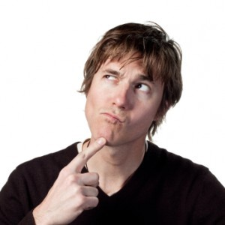
IF THE SUPREME COURT DOES NOT BELIEVE IN THE 10% SEEDING GIFT, WHY SHOULD YOU?

Slide 62
SCOTUS “REALITY OF SALE” CRUCIAL QUESTION
“Based on all of the facts, can it be reasonably expected that the purchaser will be able to meet its financial obligations on the promissory note?”

Slide 63
IS IT REASONABLE TO ASSUME THAT THE NOTE WILL BE PAID IN ACCORDANCE WITH ITS TERMS?
❑ That is What Occurs in the Real World
❑ Comports With Academia
❑ Follows the Judicial Analysis of the Income Tax Cases Including Several SCOTUS (and Other) Cases
❑ Makes Economic Sense
❑ Makes Common Sense

Slide 64
ECONOMIC REALITY
With respect to the issue of economic substance, any IRS attack would have “…to deal with the four Supreme Court cases…Clay Brown, Frank Lyon, Consumer Life, and Cottage Savings. Each upholds a transaction with no nontax motive, no nontax economic effect, and no nontax profit.”* (Citations omitted)
* Kingson, p. 642

Slide 65
SCOTUS CONCLUSIONS*
❑ Sale for a Note Payable Solely Out Of Earnings - Respected
❑ Risk Shifting – Not Essential
❑ Tax Consequences Are Meaningful
◊ Factor Considered in Real World Transactions
◊ Tax Benefits Increase the Economic Result
*Quotes in slides that follow are from Comm’r v. Clay Brown et. al., 380 U.S. 563 (1965)

Slide 66
NOTE PAYABLE SOLELY OUT OF EARNINGS
“To require a sale for tax purposes to be a financially responsible buyer who undertakes to pay the purchase price from sources other than the earnings of the assets sold or to make a substantial down payment seems at odds with commercial practice and common understanding of what constitutes a sale.”* (Emphasis Supplied)
*Clay Brown, Justice White, Majority Opinion

Slide 67
RISK SHIFTING
“…[R]isk-shifting of the kind insisted on by the Commissioner has not heretofore been considered an essential ingredient of a sale for tax purposes.”*
(Emphasis Supplied)
*Clay Brown, Justice White, Majority Opinion

Slide 68
TAX CONSEQUENCES MATTER – MAJORITY OPINION
“…[T]he Commissioner, however, ignores as well the fact that if the rents payable by Fortuna were deductible by it and not taxable to the Institute, the Institute could pay off the purchase price at a considerably faster rate than the ordinary corporate buyer subject to income taxes, a matter of considerable importance to a seller who wants the balance of his purchase price paid as rapidly as he can get it.”* (Emphasis Supplied)
*Clay Brown, Justice White, Majority Opinion

Slide 69
TAX CONSEQUENCES MATTER – CONCURRING OPINION
“Were it not for the tax laws, the respondent’s transaction with the (Institute) would not make sense, except as one arising from a charitable purpose. However, the tax laws exist as an economic reality in the businessman’s world, much like the existence of a competitor. Businessmen plan their affairs around both, and a tax dollar is just as real as one derived from another source.”* (Emphasis Supplied)
*Clay Brown, Justice Harlan, Concurring Opinion

Slide 70
ECONOMIC REALITY IN THE REAL WORLD - COMPARE
❑ A Taxable Sale of a $6 Million Business
◊ Buyer Who Must Pay 40% Income Tax on Earnings
◊ And, the Seller Also Pays Capital Gains Tax
❑ A Tax-free Transaction
◊ Charity
◊ Grantor Trust

Slide 71
GUARANTEES AS “SEED” MONEY
❑ Guarantor With the Economic Wherewithal to Pay if Called
❑ Must be Paid if Business Implodes
❑ Need Not be for Full Amount of the Note
❑ Meet Community Standards

Slide 72
IMPORTANCE OF SITUS

Slide 73
WHY MOST LAWYERS STAY LOCAL?
❑ “My Client’s Want to Stay Local!”
◊ Did You Ask the Client?
◊ Really?
◊ Then You Did Not Explain the State Disparities Correctly
Can Select the Best Laws of Different States Provided Each Has Adequate Contacts
Can Rent Situs Cheaply

Slide 74
PRIMARY FACTORS IN SELECTING JURISDICTION
❑ RAP
❑ Creditor Protection Laws
◊ No “Exception Creditors”
❑ No State Income Taxes
❑ Cost of Renting Jurisdiction
❑ Cooperation of Situs Trustee

Slide 75
RECYCLE
IRS
TRUST FOR CHILD
OTHER PREDATORS
GRANDCHILD #1
GRANDCHILD #1
GRANDCHILD #1
GRANDCHILD #1
GRANDCHILD #1
GRANDCHILD #1
GRANDCHILD #1
GRANDCHILD #1
GRANDCHILD #1
GRANDCHILD #1
GRANDCHILD #1
GRANDCHILD #1
GRANDCHILD #2
GGC A
GGC B
GGC C
GGC D
GGC E
GGC F
And so on, all Subject to Amendment through a Power of Appointment by the Senior Generations.

Slide 76
CONTROLS “OWN NOTHING, BUT CONTROL EVERYTHING”*
PLANNING IDEAS WISH LIST #1, #2 AND #3
*Quote attributable to John D. Rockefeller

Slide 77
BENEFICIARY CONTROLLED TRUST DUAL TRUSTEESHIP
❑ Primary Beneficiary Controls
◊ Investments
◊ Identity of Independent Trustee
Independent (Distribution) Trustee Controls
◊ All “Tax Sensitive” Decisions
Situs Trustee – Can Be One of the Foregoing
◊ Distribution and Situs Trustee Often the Same

Slide 78
AMENDABLE/FLEXIBLE “RE-WRITE” POWERS
WISH LIST #3
❑ Special Power of Appointment (“SPA”)
Deal With Changing Laws, Family Dynamics and Needs
Deal With Dissident Subordinate Beneficiaries

Slide 79
LIFE INSURANCE PLANNING

Slide 80
ALL TRUSTS SHOULD HAVE LIFE INSURANCE PROVISIONS IN THEM UNLESS IMPERMISSIBLE AS A MATTER OF LAW
❑ Components of LI Policy
◊ Inside Build-up
◊ Death Benefit

Slide 81
LIFE INSURANCE OWNED BY A THIRD PARTY TRUST MAKES THE POLICY MORE VALUABLE
❑ Indirect Access to a Conservative Asset Backed by a Powerful, Regulated Financial Institution
DB Out of Estate
Funding Complexities and Limitations Avoided

Slide 82
PLANNING TO AVOID 3 YEAR TRANSFERS IN CONTEMPLATION OF DEATH TRANSFERS
❑ Client Made a Transfer of $5 Million Face Policy to an ILIT
Client Subsequently Learns He/She Will Not Survive 3 Years From the Transfer
What Can You Do?

